Slide 1







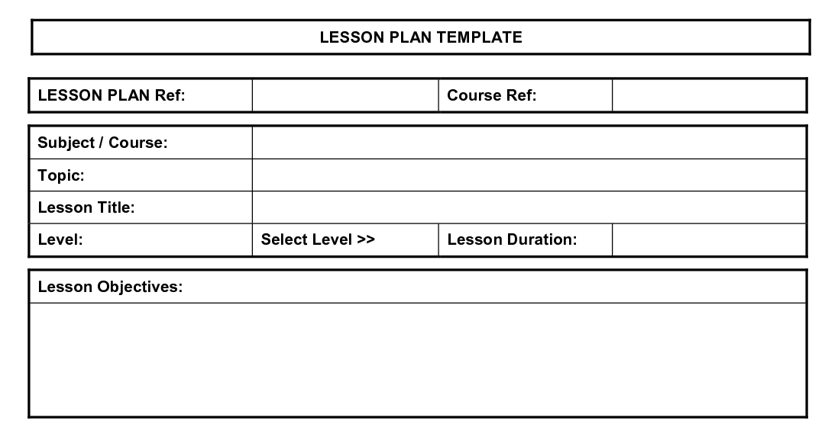




The 5 Minute Ofsted Plan
….print and scribble your way to a well planned Ofsted Inspection!
SEF Planner
Share With
Led by: Completion: Review:
Achievement
Quality of Teaching
Behaviour & Safety
Quality of Leadership
Governors
Others
Staff
School Information Regulations
Led By:
DOCUMENTS
Led by:
Completion:
Stored:
Case Studies
Students/pupils:
Led By:
Completion:
Led By:
Practical Arrangements
Single Central Record
Check Led by:
Completion:
Review Date:
Led By:
Stephen Tierney (2013) @LeadingLearner & Ross McGill @TeacherToolkit

Slide 2
Context – (What each area means?)
Self-Evaluation Form Planner
Putting together the Self-Evaluation Form is a time consuming task and whilst not an absolute requirement it is a brave or foolhardy school that does not keep the document up to date.
The Achievement of Students section is possibly best updated after the summer examinations and once the unvalidated RAISE document comes into schools in either October (primary) or December (secondary).
The Quality of Teaching section needs to be kept up to date with data from the latest round of graded lesson observations and revisited when new lesson grading data comes in.
A full September analysis of the previous academic year’s behaviour & attendance data and how you’ve kept children safe can benefit from a mid-year refresh, to judge the impact of any new initiatives.
The Quality of Leadership section partially flows out of the previous three sections and so timetable that accordingly.
Remember when writing your self-evaluation form: PIE – Point, Impact, Evidence. The Ofsted Team are interested in the impact you have made not long descriptive or narrative passages on what you have done. This helps keep the self-evaluation form short and focussed.
Share With
Once you have the self-evaluation form completed consider key groups of stakeholders who will need to access, know and scrutinise the document. Keeping the governors or directors informed and enabling them to hold the school accountable for standards is critical. This can be built into the Headteacher’s Report submitted to the Governing Bodies or Academy Board. Thinking about which groups of staff to share the self-evaluation form with – senior leaders, heads of departments, subject leaders, all teachers etc – needs to be considered and thought through. What’s the “hymn sheet” everyone will be singing from? There may be other stakeholders you want to inform. An experience local authority officer, fellow headteacher, friendly ex-HMI or inspector all may be able to give you feedback and ask questions to help you finalise and hone your self-evaluation form.
School Information Regulations
The School Information Regulations were amended and came into force on the 1st September 2012. Making sure the required information is available on the website is one for the start of the academic year. The link below takes you to the “Key Information” that needs to be published. The Ofsted Team may well be looking for this on your website before you even get the call.
Parent View
Ofsted now gain a lot of their information about parents’ perspective on the school via the Parent View website. When an inspection is announced a school will be expected to send parents a letter with details of the website that encourages them to complete the questionnaire. If you are not proactive a few disgruntled and unrepresentative parents may be the only ones to complete the Parent View Questionnaire. Why not think about managing responses from parents during the year? It could give you some really useful insights and hopefully supportive data for your self-evaluation form. For example, we would suggest asking all parents of new Year 7 students to complete it during the first half term. Avoid the third Monday in January, often called “Blue Monday”, when we are at our collective most depressed.

Slide 3
Context – (What each area means?)
Single Central Record
The Single Central Record is a key part of ensuring the Safeguarding of children and is looked at early on in the inspection. Schools often have a number of key weaknesses – Ofsted Inspectors know these – in terms of ensuring staff have the necessary Disclosure & Barring Service (DBS) Certificates: Peripatetic teachers, Volunteers, Staff who require a work visa, Recently appointed staff (which can be a particular issue for inspections early in the academic year) and Increasingly staff who were appointed prior to the Criminal Records Bureau coming into being have the required Disclosure & Barring Service (DBS) Certificates.
Why not run a random check a couple of times a year checking staff – remember the key weaknesses.
Lesson Plans
There is no requirement to give an Ofsted Inspector a lesson plan. Whether you decide to require teachers to have lesson plans is a school decision but you want to make a decision after careful consideration of the pros & cons – time spent on writing lesson plans the night before an inspection can’t be used on other priorities - and well in advance of the inspection. You may decide:
Staff will not be expected to have lesson plans
Staff will be expected to have a lesson plan with number of students from key groups identified – free school meals, SEN, statemented, English as an additional language, children looked after – and the key learning for the lesson
Staff will be expected to have a full lesson plan including methodologies to be used
Practical Arrangements
This needs a simple bit of thought about which is the best room for the inspection team, where will they park, access to Wi-Fi and refreshments etc.
Documents
Finally there are a number of documents that the school will be asked for and the lead inspector will require them fairly quickly. Why not make sure you have them all stored electronically in one place. It would be very sensible to ensure a few senior leaders have access to them as the phone call may well come when the headteacher is out. Google Drive, Dropbox or various storage devices are all equally useful ways to achieve this. By no means an exhaustive list, documents regularly asked for, in addition to the Self-Evaluation Form, are:
School Development/Improvement Plan
School timetable
Staff List
Times of the School day
External Reports (Investors in People, Excellence in English, Advisors’ Reports)

